Slide 1
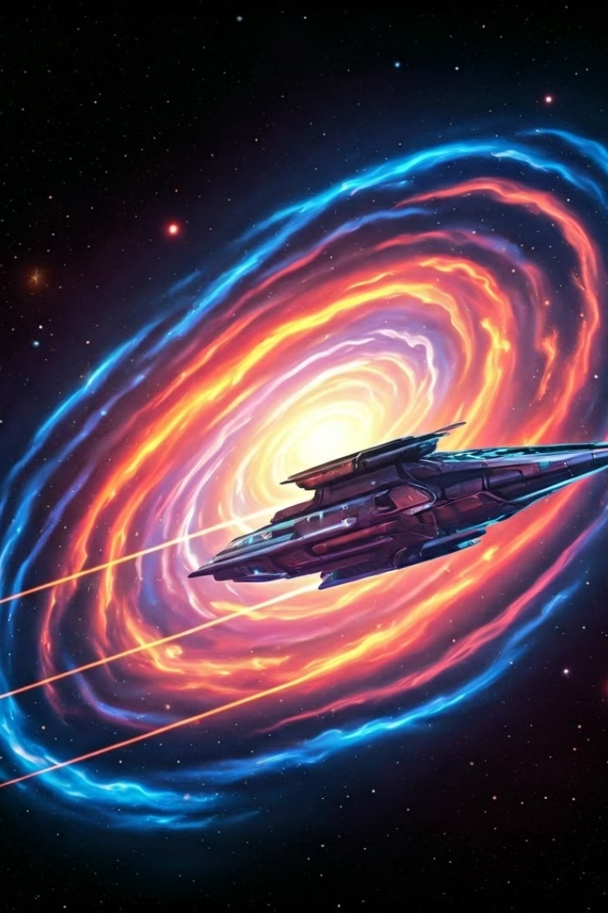

Zero-G Star Collector
Welcome to Zero-G Star Collector, an exciting space adventure game for casual gamers of all ages. Embark on a journey through the cosmos, collect stars, and outmaneuver obstacles in this fast-paced adventure.
by AUTO MINDS

Slide 2
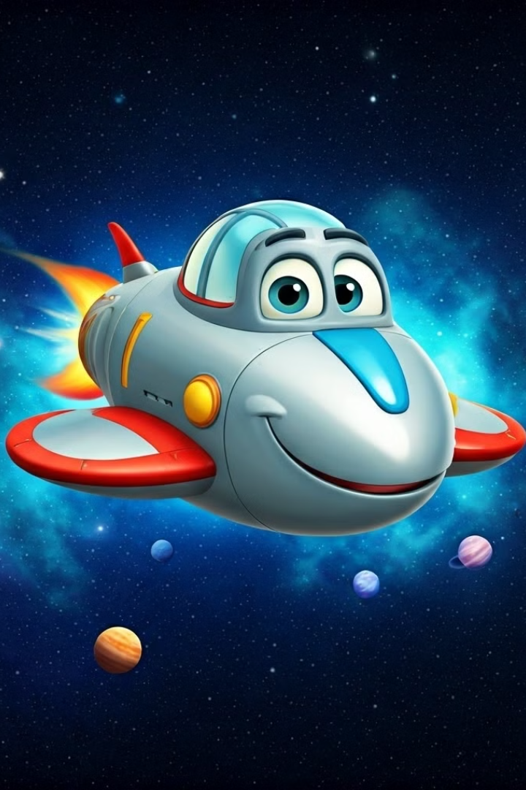
Introduction to the Game
Space Adventure
Simple Gameplay
Zero-G Star Collector is a fun and engaging space adventure game where players control a spaceship in a zero-gravity environment.
The game is easy to learn, with intuitive controls and a simple gameplay loop.
Target Audience
The game is suitable for casual gamers of all ages, especially those who enjoy space-themed games.

Slide 3
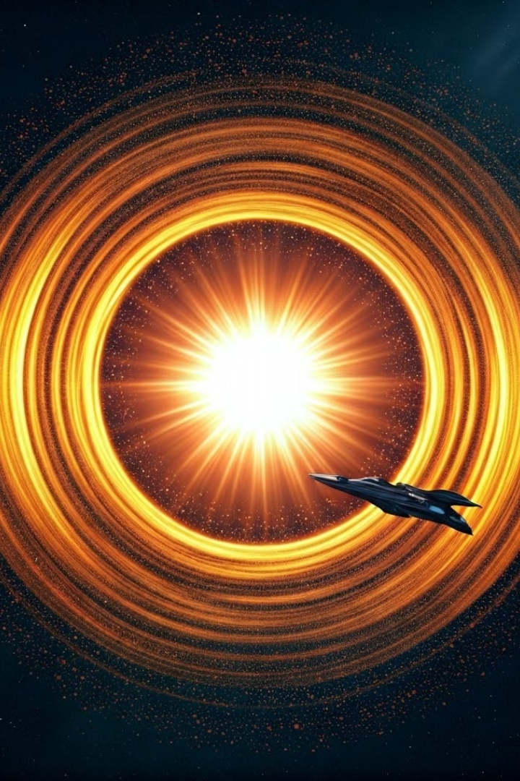
Overview of the Game Objectives
1
Star Collection
2
Obstacle Avoidance
The primary goal of the game is to collect as many stars as possible.
Players must carefully navigate their spaceship to avoid collisions with obstacles.
3
High Scores
Players aim for the highest score by collecting stars and completing challenges.

Slide 4
Key Game Features
Dynamic Environments
Varied Obstacles
Power-ups
Explore diverse space environments, from asteroid fields to nebulae.
Encounter different types of obstacles, including asteroids, meteoroids, and space debris.
Collect power-ups to enhance your spaceship's abilities and gain an advantage.

Slide 5
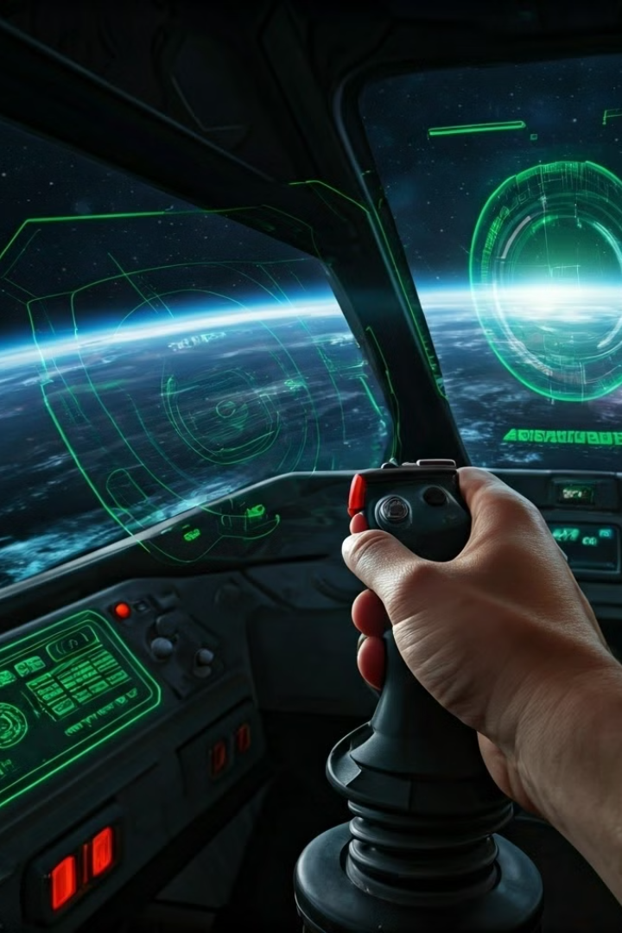



Gameplay Mechanics
Ship Control
Players use intuitive controls to maneuver their spaceship in zero-gravity.
Star Collection
Collecting stars increases the player's score and unlocks new levels.
Obstacle Avoidance
Players must use their skills to avoid collisions with obstacles, which result in a loss of points.

Slide 6
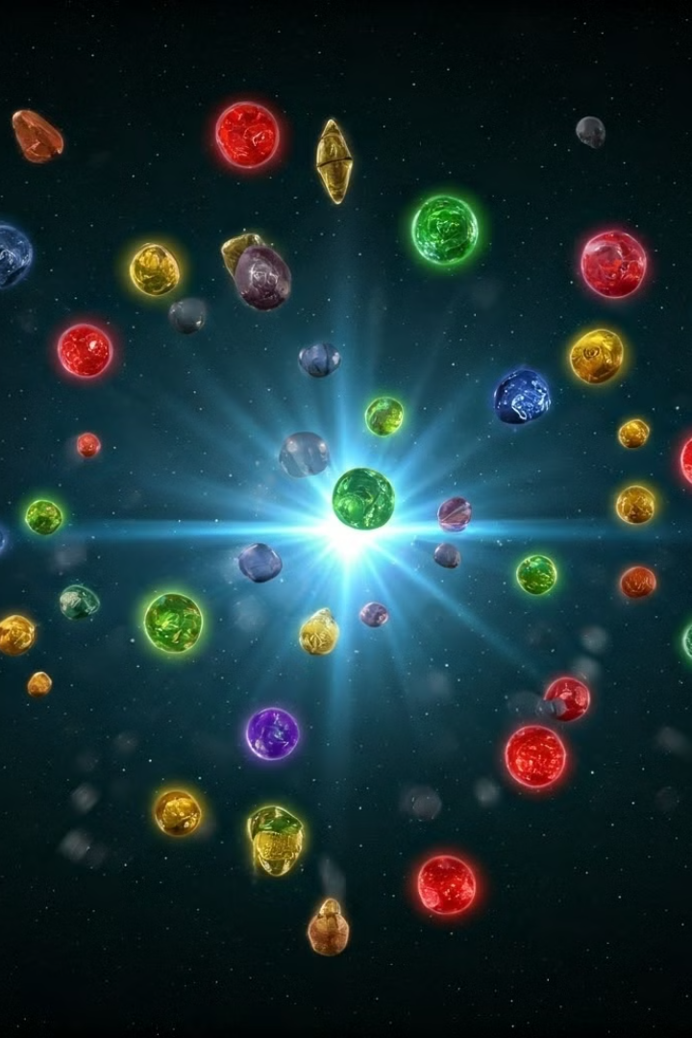



Power-ups and Upgrades
Shields
Shields protect the spaceship from collisions with obstacles.
Speed Boost
Speed boosts allow the spaceship to move faster, increasing its ability to collect stars and dodge obstacles.
Star Magnet
Star magnets attract stars towards the spaceship, making them easier to collect.

Slide 7
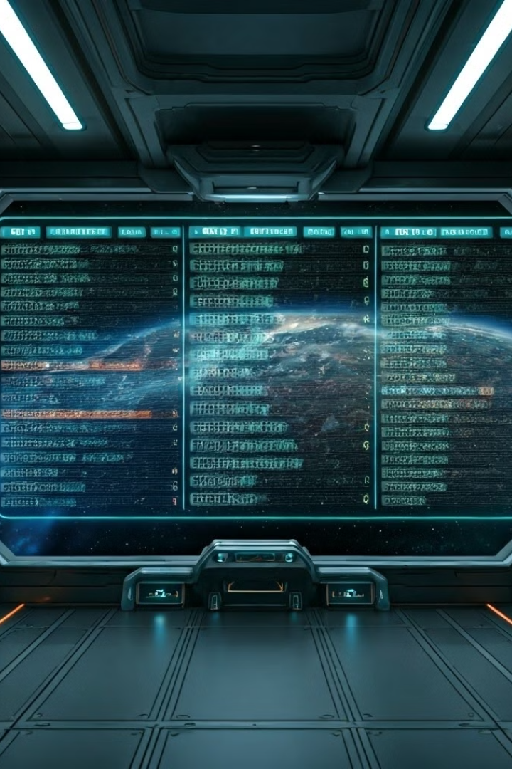
Scoring and Leaderboards
1
Score System
Players earn points for collecting stars and completing challenges.
2
Leaderboard
Compare your scores with other players on the global leaderboard.
3
Achievements
Unlock achievements for completing specific goals and challenges.

Slide 8
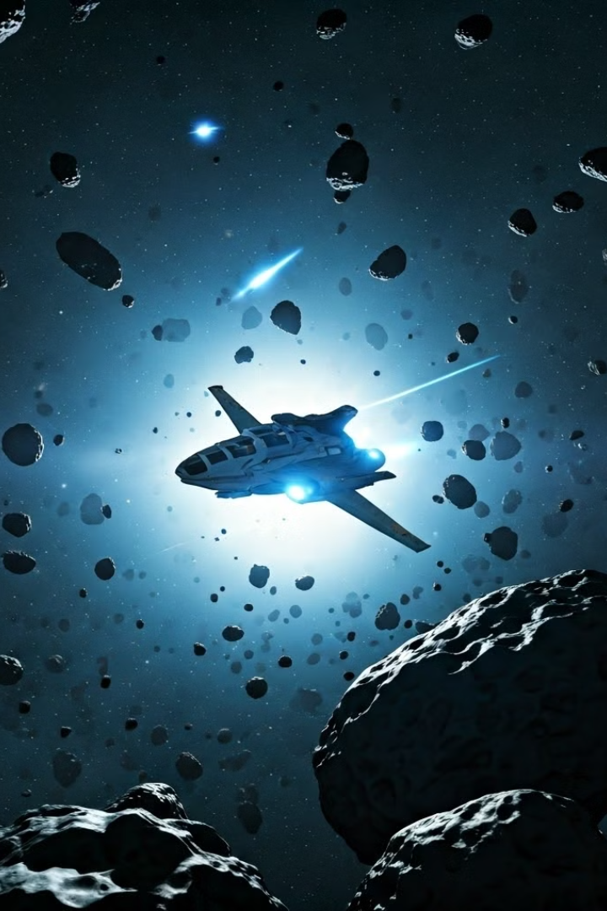
Challenges and Obstacles
Asteroid Fields
Navigating through dense fields of asteroids.
Meteoroid Showers
Dodging rapidly moving meteoroids.
Space Debris
Avoiding collisions with scattered space debris.

